Slide 1








TRAINING SESSIONS
WELCOME
open-security-summit.org
All materials will be published under a CC or open source license

Slide 2
WHAT TO EXPECT (ON TRAINING)
Learn by working with small, diverse teams
10-day, high-energy experience
Facilitated collaboration between Developers and security professionals
Practitioner led training sessions
Creating solutions for real world problems

Slide 3
WHAT WE EXPECT FROM YOU :)
Participation
Care deeply
Mutual respect
Objective distance
Challenge directly
Be Solution Focused

Slide 4
Summit == Openness
Sessions will be video recorded, sometimes live streamed as well, and will later be shared on social media (i.e YouTube, Twitter, Linkedin).
If you do not want to be identified, please take personal precautions (such as not activating your video, using N/A as your name during the session).
Everything created at the Summit is released under a CC or Open Source license

Slide 5
RESPECT
We are all here to collaborate on topics we have chosen as a community, no-one should be discriminated or harassed based on their race, gender, age, religion, appearance, inexperience, or anything else.
We are all expected to preserve a certain level of professionalism and respect.
If you feel any kind of abusive behaviour against yourself or anyone else during the summit, please report to one of the organisers as soon as you can; so that it can be handled and prevented from future occurrence.

Slide 6


SHARE YOUR VIEWS
#OSS2020
OSS Slack Invite Link
AND LEARN :)

Slide 7
ALL SESSIONS AT
OPEN SECURITY SUMMIT 2020
WILL BE RECORDED AND SHARED WITH THE PUBLIC ☺
All materials will be published under a CC or open source license

Slide 8
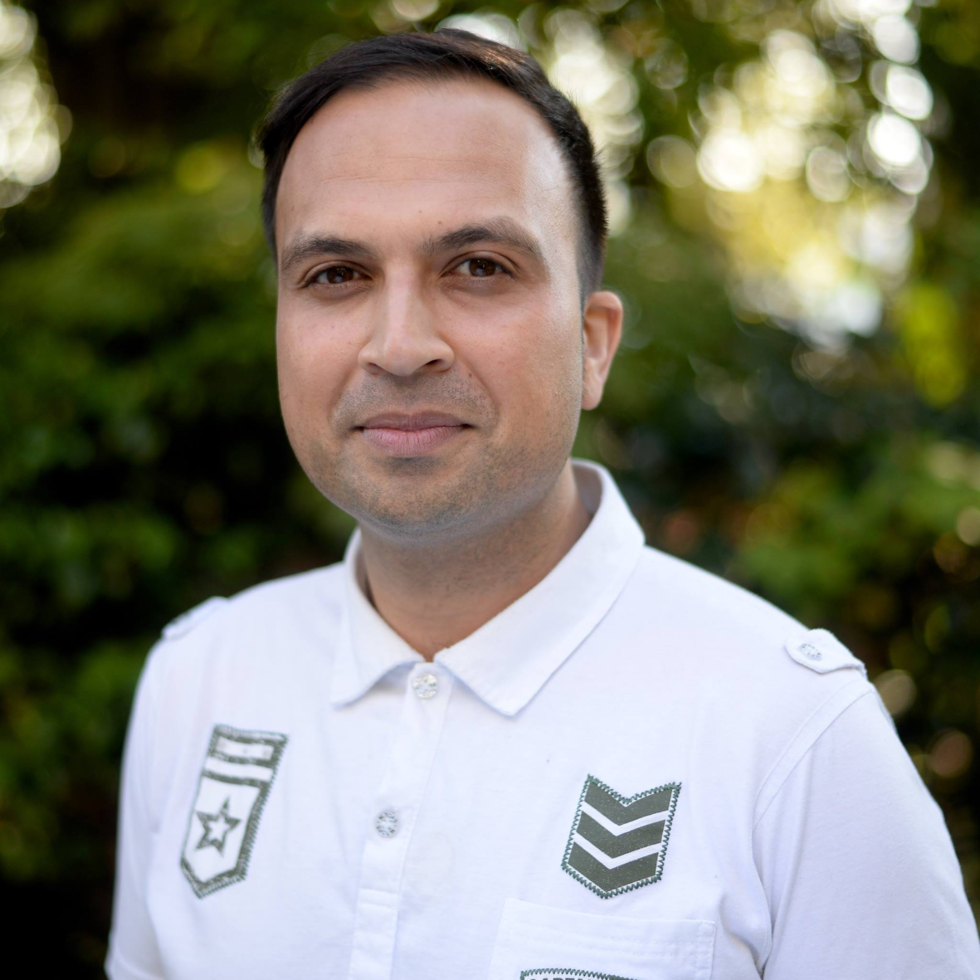
Goher Mohammad
Head of InfoSec @ L&Q
Background:
Finance
Media
Fintech
E-Commerce

Slide 9
Rules of engagement
Open and honest
Allow others to speak
There is no wrong or right so don’t be shy to speak
Its interactive
Questions in the chat or reaction preferred
Head of InfoSec @ L&Q
Background:
Finance
Media
Fintech
E-Commerce

Slide 10
What is Wardley Mapping?

Slide 11
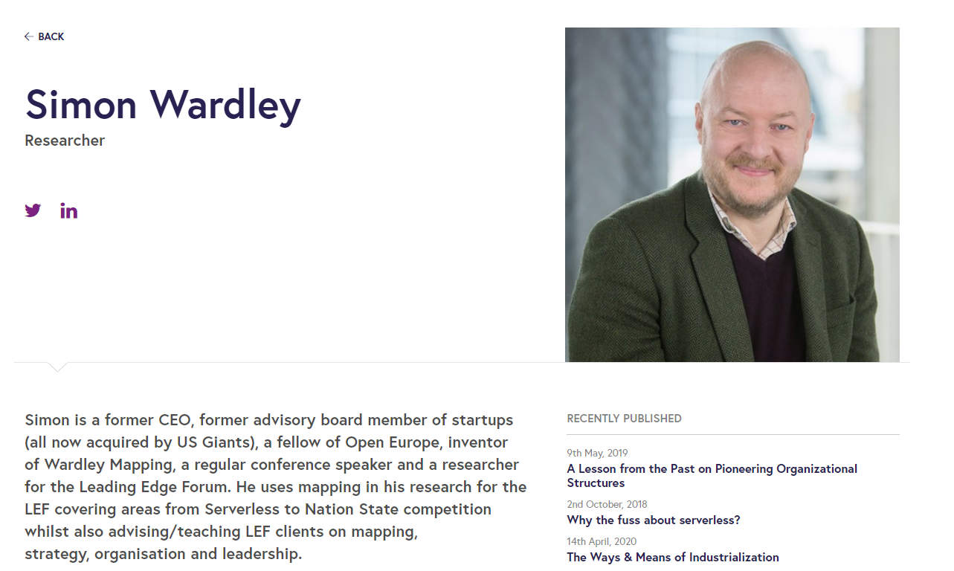
Brainchild of Simon Wardley
More information can be found here about Simon Wardley and Wardley Maps:
https://medium.com/wardleymaps

Slide 12
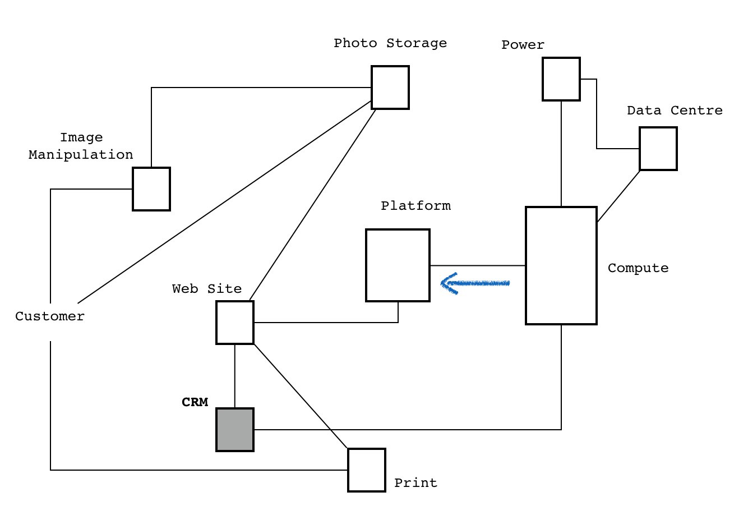
This is normally seen as ‘mapping’

Slide 13
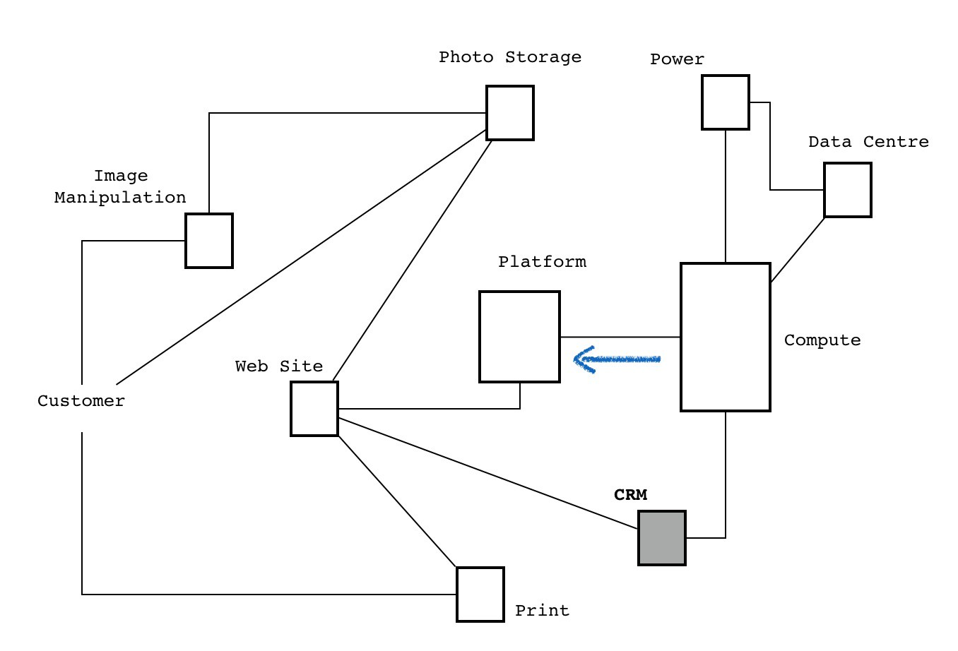
Has anything changed?

Slide 14
Basically it is a diagram!!

Slide 15
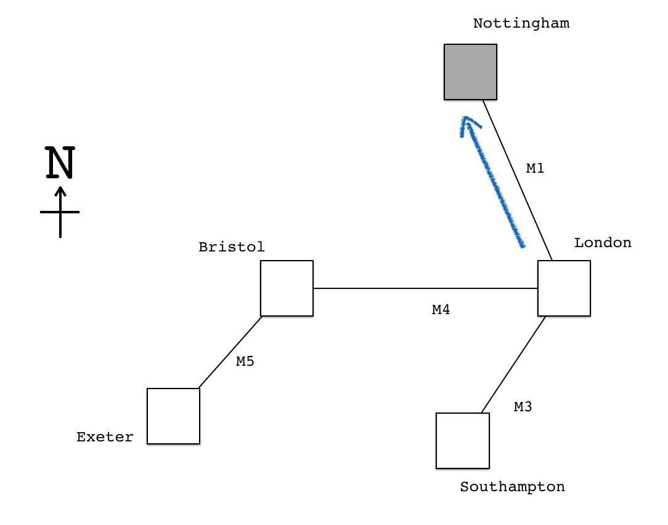
Is this a map?

Slide 16
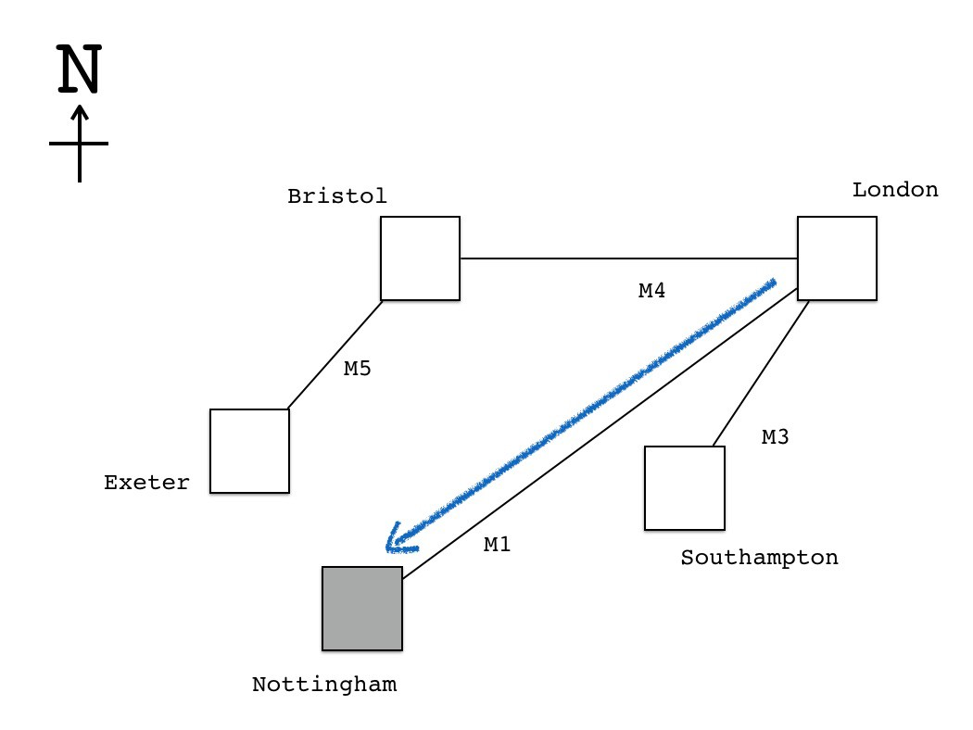
Changing Nottingham changes the meaning of the map!

Slide 17
..but it is a map that’s meaningful!!

Slide 18
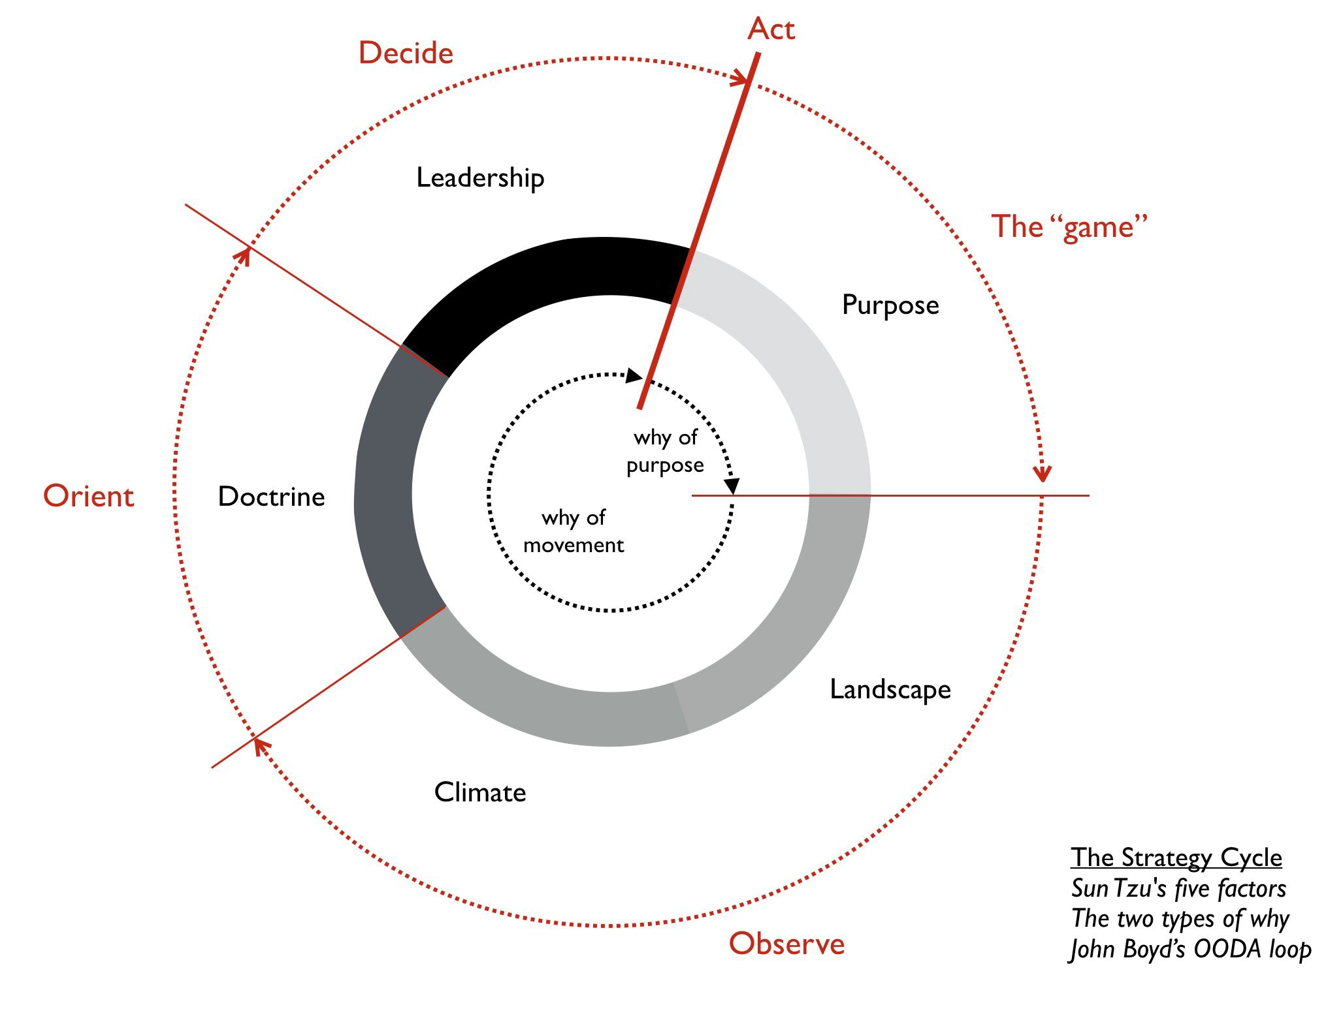
‘True’ Mapping allows Strategy, Visibility and Direction

Slide 19
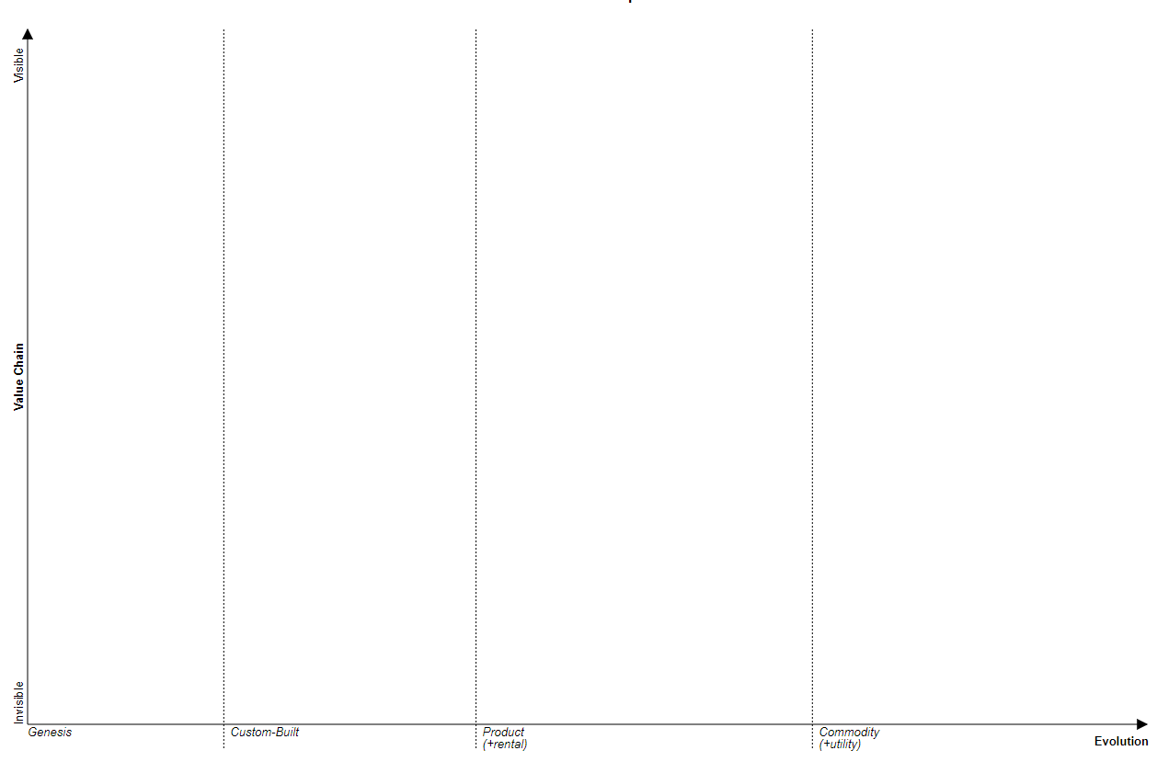
This is a ‘Wardley Map’

Slide 20
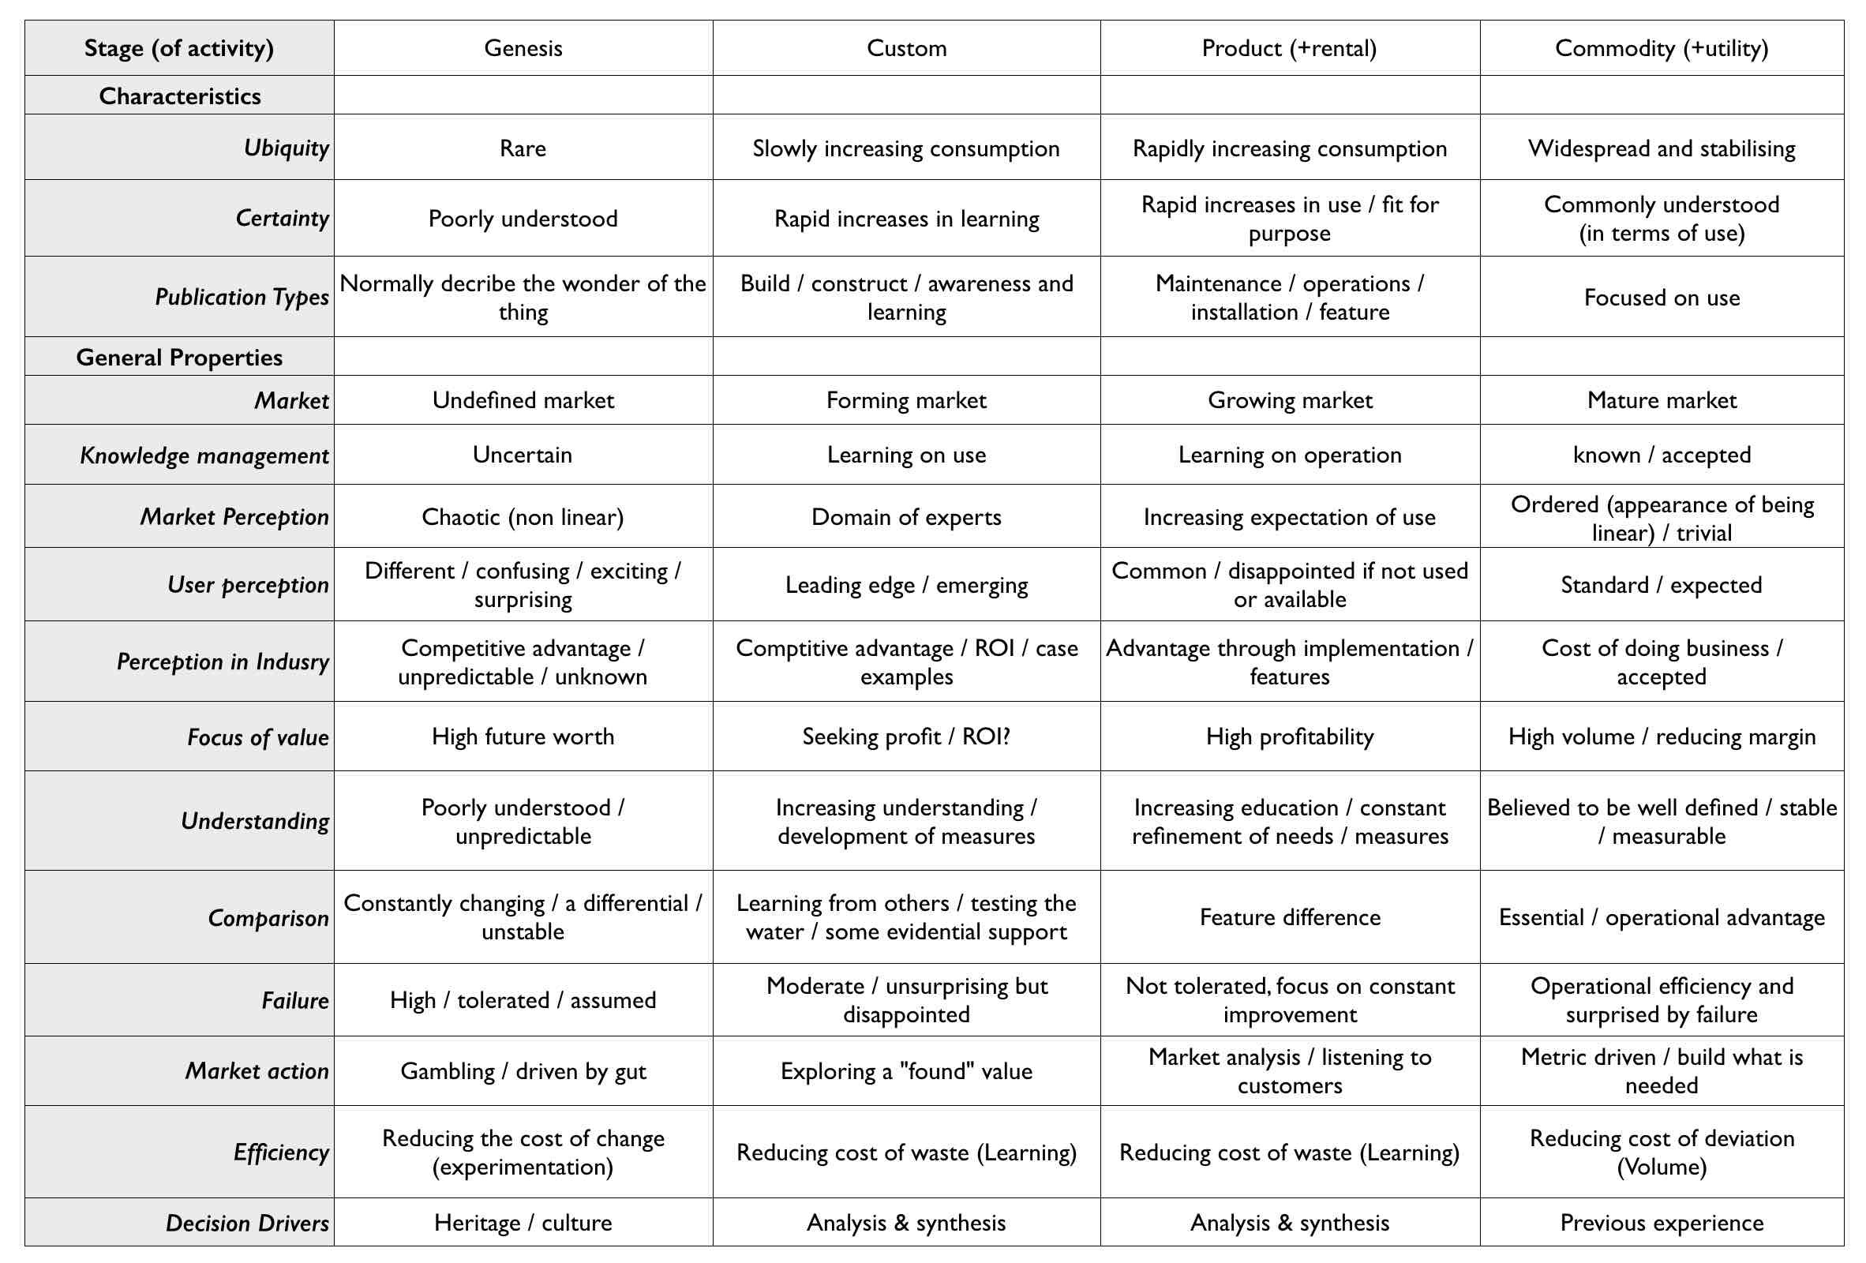
Evolution cheat sheet

Slide 21
Previous diagram now mapped

Slide 22


Slide 24
Meaning of map completely changes and becomes useful

Slide 25
How can this be applied?

Slide 26
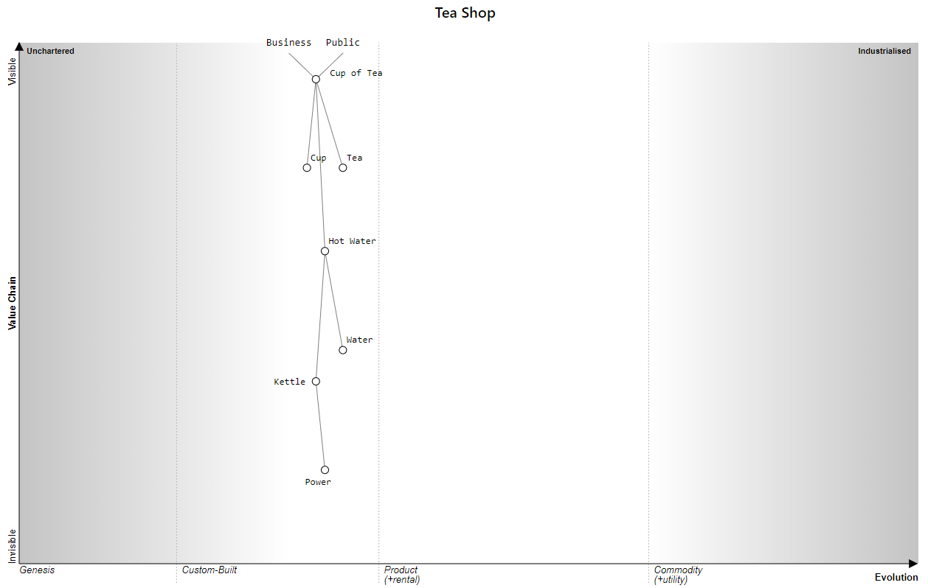

Slide 27
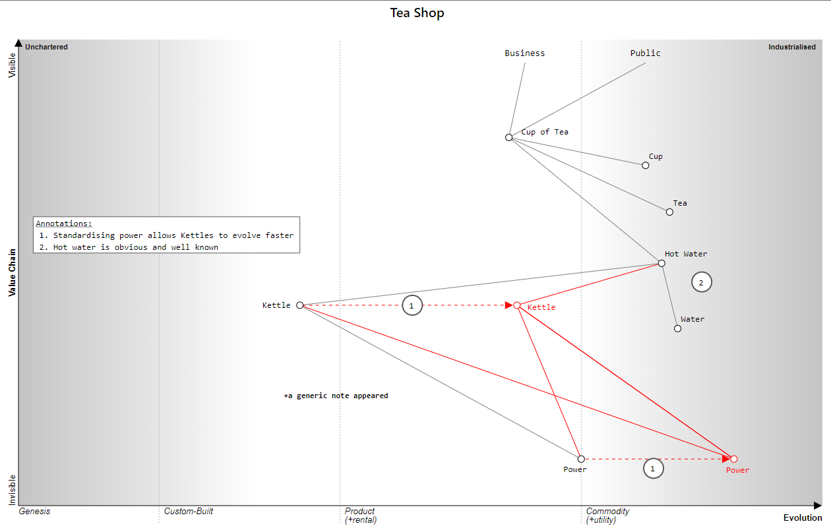

Slide 28
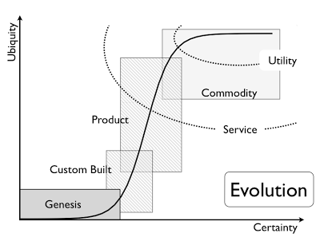
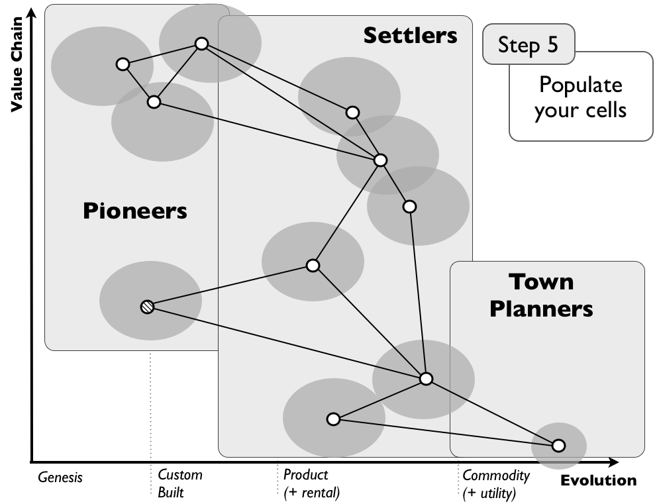
Context to populate a Wardley Map

Slide 29
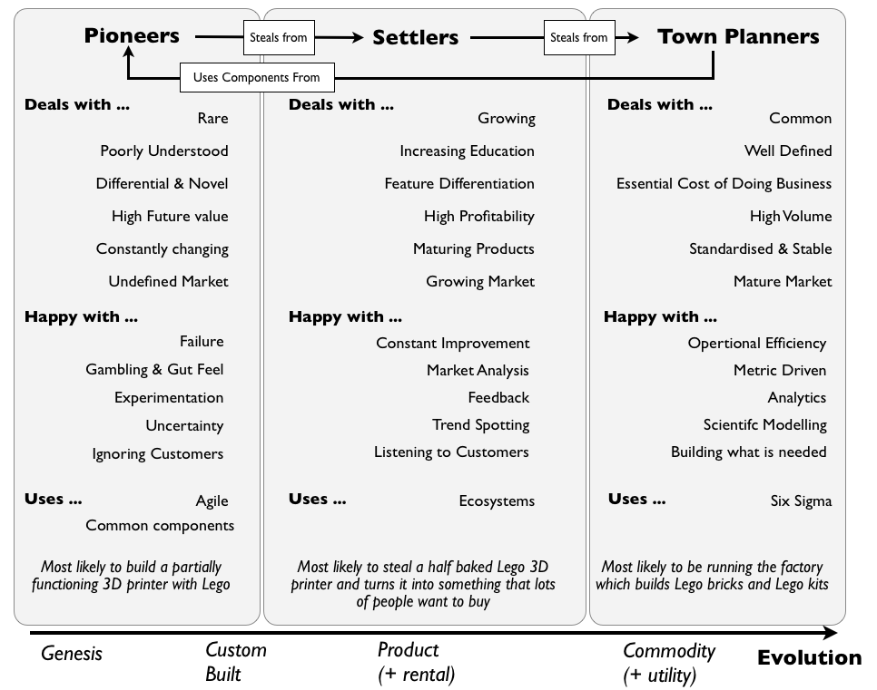
What are Pioneers, Settlers and Town Planners?

Slide 30
Create your own!

Slide 31
Create your own Wardley Map! - Exercise
Map out making Strawberry Milkshake
Go to:
https://onlinewardleymaps.com/

Slide 32
A real life example in security

Slide 33
Incident Reported
visible
Ticket Logged
Initial Assessment
Get more information
Verify Data
Assess Impact
Value Chain
Follow Escalation Channel
Contain the Incident
Remediation Actions
Lessons Learned
invisible
Weak
Good
Advanced
Expert

Slide 34
Incident Response
visible
Initial Assessment
Ticket Logged
Incident Reported
Verify Data
Value Chain
Get more information
Contain the Incident
Lessons Learned
Assess Impact
Information Capture
Remediation Actions
invisible
Weak
Good
Advanced
Expert

Slide 35
Incident Response
visible
Initial Assessment
Ticket Logged
JIRA
Incident Reported
Verify Data
Value Chain
IT Teams
Get more information
Contain the Incident
Log Files
Lessons Learned
Assess Impact
Risk Assessment
Information Capture
Remediation Actions
invisible
Weak
Good
Advanced
Expert

Slide 36
Roadmap Mapping - Example

Slide 37
1. Cyber Security Governance – Q1 2018
visible
Info Sec Awareness
Value Chain
Governance and Leadership
Risk Management
Policies
Supplier Management
invisible
DevSec Awareness
Weak
Good
Advanced
Expert

Slide 38
1. Cyber Security Governance – target
visible
Info Sec Awareness
Value Chain
Governance and Leadership
Risk Management
Policies
Key
Supplier Management
Q1 2018
Target
invisible
DevSec Awareness
Weak
Good
Advanced
Expert

Slide 39
1. Cyber Security Governance – Status of work
Infosec Awareness
Security Champion programme
Review and improvement of online training
Security awareness weeks
Supplier Management
3rd party questionnaire and review
Embed process in tender process
Retrospective review of current contracts
Policy creation, review and implementation
Policies
Policy alignment to ISMS Standard
Policy creation, review and implementation
Policy approval and implementation

Slide 40
1. Cyber Security Governance - cont
Governance and Leadership
Roles and responsibilities defined
Infosec steering committee established
Hierarchy of risk ownership
Risk Management
Mature Technology risk appetite based on ERM
Define and embed capture process with scalability
Set up Risk and Incident committee with regular cadence
Dev Sec Awareness
Training module to be defined and setup in e-learning module
Security champion programme integration
Developer training embedding best practice SDLC

Slide 41
1. Cyber Security Governance – actual vs target
visible
Info Sec Awareness
Value Chain
Governance and Leadership
Risk Management
Policies
Key
Supplier Management
Q1 2018
Target
invisible
Actual
DevSec Awareness
Weak
Good
Advanced
Expert

Slide 42
2. Cyber Security Defence and Response – Q1 2018
visible
Value Chain
Security Incident Response
Security Operations
Crisis Management
invisible
Critical information
Threat Intelligence
Weak
Good
Advanced
Expert

Slide 43
2. Cyber Security Defence and Response – target
visible
Value Chain
Security Incident Response
Security Operations
Key
Q1 2018
Crisis Management
Target
invisible
Critical information
Threat Intelligence
Weak
Good
Advanced
Expert

Slide 44
2. Cyber Security Defence and Response – Status of work
Security Incident Response
Build process for Incident Response via playbook
Define PoC for frontline, triage and resolution
Crisis Management
Review, update, define and approve BCP and DR processes
Test BCP and DR processes on a regular basis
Critical Information
Define and catalog critical assets with tracking
Understand and track critical assets based on PII and confidential data flows

Slide 45
2. Cyber Security Defence and Response - cont
Threat Intelligence
Proactive monitoring via SIEM and other monitoring tools
Track and monitor trends and patterns via machine learning
Security Operations
Set up SOC function and point of contact
Establish first line assessment and triage of incidents
Mature monitoring capability focussing on security and network

Slide 46
2. Cyber Security Defence and Response – actual vs target
visible
Value Chain
Security Incident Response
Security Operations
Key
Q1 2018
Crisis Management
Target
invisible
Actual
Critical information
Threat Intelligence
Weak
Good
Advanced
Expert

Slide 47
PCI Audit Mapping - Example

Slide 48
PCI Audit Before
visible
Auditor
Audit Storage
Excel
Group Security Team
Jira
Policies
G Drive
Value Chain
Policies Review
Policy Owners
Techops Team
HR Team
Cust Serv Team
Legend
Auditor Flow
GS Flow
Team Flow
Teams
Tasks
Tools and Data
Dev Team
Evidence Storage
invisible
Evidence
Policy Storage
Evidence Review
Weak
Good
Advanced
Expert

Slide 49
PCI Audit Process Maturity
visible
Removal of Excel
Auditor
Audit Storage
Excel
Group Security Team
Jira
Policies
G Drive
Value Chain
Policies Review
Policy Owners
Techops Team
HR Team
Cust Serv Team
Legend
Auditor Flow
GS Flow
Team Flow
Teams
Tasks
Tools and Data
Dev Team
Evidence Storage
invisible
Evidence
Policy Storage
Evidence Review
Weak
Good
Advanced
Expert

Slide 50
PCI Audit Process Maturity
visible
Removal of Excel
Auditor
Audit Storage
Excel
Group Security Team
Jira
Policies
G Drive
Value Chain
Policies Review
Policy Owners
Techops Team
HR Team
Cust Serv Team
Legend
Auditor Flow
GS Flow
Team Flow
Teams
Tasks
Tools and Data
Dev Team
Evidence Storage
Central Storage
invisible
Evidence
Policy Storage
Evidence Review
Weak
Good
Advanced
Expert
Security Controls
Vulnerabilities
Risks

Slide 51
PCI Audit Process Maturity
visible
Removal of Excel
Auditor
Audit Storage
Excel
Group Security Team
Jira
Policies
G Drive
Value Chain
Policies Review
Policy Owners
Techops Team
HR Team
Cust Serv Team
Legend
Auditor Flow
GS Flow
Team Flow
Teams
Tasks
Tools and Data
Dev Team
Evidence Storage
Central Storage
invisible
Evidence
Policy Storage
Evidence Review
Weak
Good
Advanced
Expert
Security Controls
Vulnerabilities
Risks

Slide 52
PCI Audit New Process Used
visible
Auditor
Audit Storage
Group Security Team
Policy Owners
Jira
G Drive
Value Chain
Policies Review
Policies
Policy Storage
Techops Team
Evidence Storage
HR Team
Cust Serv Team
Evidence
Legend
Auditor Flow Reduction
Auditor Flow
GS Flow
Team Flow
Teams
Tasks
Tools and Data
Dev Team
Evidence Review
Central Storage
invisible
Weak
Good
Advanced
Expert

Slide 53
Thank you

